Slide 1

Sean Barnum
February 2013
https://stix.mitre.org

Slide 2




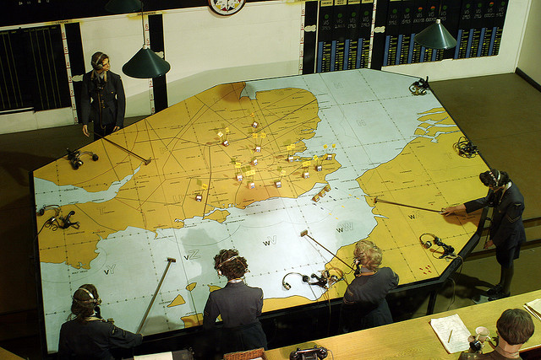


Diverse and evolving threats
Balance inward & outward focus
Standardized
Threat
Representation
Proactive & reactive actions
Recon
Weaponize
Deliver
Exploit
Control
Execute
Maintain
Information sharing
Need for holistic threat intelligence

Slide 3
Information Sharing
Cyber threat information (particularly indicators) sharing is not new
Typically very atomic and very limited in sophistication
IP lists, File hashes, URLs, email addresses, etc.
Most sharing is unstructured & human-to-human
Recent trends of machine-to-machine transfer of simple/atomic indicators
STIX aims to enable sharing of more expressive indicators as well as other full-spectrum cyber threat information.

Slide 4
Cost to Adversary
Trivial/cheap to hop between IP addresses
Slightly more expensive to hop between domains
Difficult & expensive: Changing tactics and procedures to evade behavioral detection

Slide 5



Evolution of Standardized Representations for Threat
Vulnerabilities
Weaknesses
Attack Patterns
Malware Behavior
Based on
Cyber Observables
IDXWG community of Threat Intel and Incident Response experts begins working on defining a standard representation for cyber threat indicators
?
Threat Indicators
What is an Indicator?
Community iterated on scope
Defined Indicator scope as a part of broader cyber threat information architecture
Structured threat information architecture evolved into STIX

Slide 6
What is STIX?
Language
Specify
Capture
Characterize
Communicate
Cyber Threat Information
Community-driven
Consistency
Clarity
Support automation
Notes:
The Structured Threat Information eXpression (STIX) is a language, being developed in collaboration with any and all interested parties, for the specification, capture, characterization and communication of cyber threat information.

Slide 7
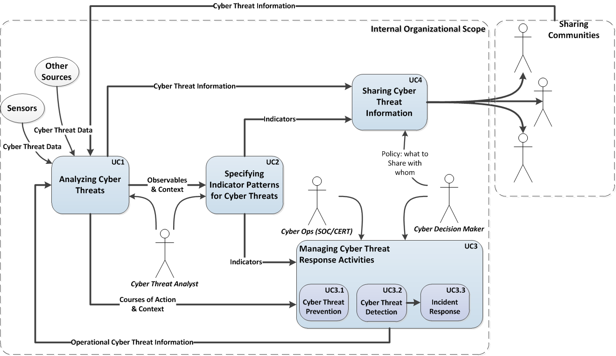
STIX Use Cases
STIX provides a common mechanism for addressing structured cyber threat information across and among this full range of use cases improving consistency, efficiency, interoperability, and overall situational awareness.

Slide 8
STIX Guiding Principles
Expressivity
Integrate rather than Duplicate
Flexibility
Extensibility
Automatability
Readability

Slide 9






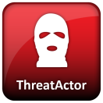

What is “Cyber (Threat) Intelligence?”
Consider these questions:
What activity are we seeing?
What threats should I look for on my networks and systems and why?
Where has this threat been seen?
What does it do?
What weaknesses does this threat exploit?
Why does it do this?
Who is responsible for this threat?
What can I do about it?

Slide 10
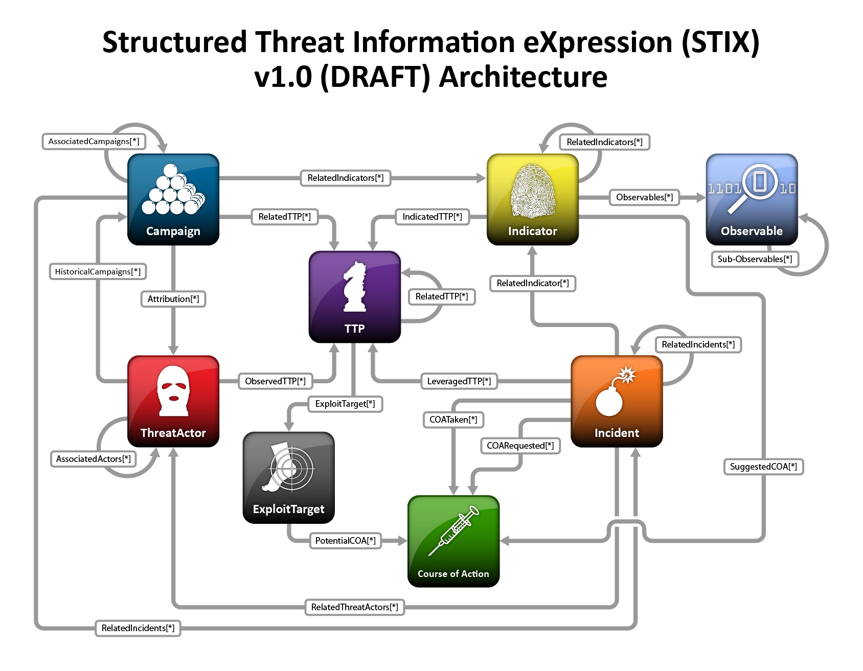

Slide 19
Why were they doing it?
Why should you care about it?
What you are looking for
What exactly were they doing?
Where was it seen?
Who was doing it?
What should you do about it?
What were they looking to exploit?

Slide 20
Implementations
Initial implementation has been done in XML Schema
Ubiquitous, portable and structured
Concrete strawman for community of experts
Practical structure for early real-world prototyping and POC implementations
Plan to iterate and refine with real-world use
Next step will be a formal implementation-independent specification
Will include guidance for developing XML, JSON, RDF/OWL, or other implementations

Slide 21
Enabling Utilities
Utilities to enable easier prototyping and usage of the language.
Utilities consist of things like:
Language (Python) bindings for STIX, CybOX, MAEC, etc.
High-level programmatic APIs for common needs/activities
Conversion utilities from commonly used formats & tools
Comparator tools for analyzing language-based content
Utilities supporting common use cases
E.g. Email_to_CybOX utility supporting phishing analysis & management
Open communities on GitHub (STIXProject, CybOXProject & MAECProject)

Slide 22





Adoption & Usage
Still in its early stages but already generating extensive interest and initial operational use
Actively being considered by several information sharing communities
Active interest from several large “user” organizations
Active interest from some service/product vendors

Slide 23






























A sampling of some of the organizations contributing to the STIX conversation includes:

Slide 24
Current Focus
Make it easier for people to understand and use STIX
Improve documentation
Develop supporting utilities
Provide collaborative guidance
Gather feedback
Refine and extend the language based on feedback and needs

Slide 25
Where to Learn More
STIX Website
http://stix.mitre.org
STIX Whitepaper
http://stix.mitre.org/about/documents/STIX_Whitepaper_v1.0_(Draft).pdf
STIX Schemas
http://stix.mitre.org/language/
STIX Use Case Examples document
http://stix.mitre.org/about/documents/STIX_Use_Case_Examples_v1.0.pdf
STIX Discussion List
http://stix.mitre.org/community/registration.html
IDXWG email list
Simply request an invite at stix@mitre.org
STIX Handshake Space
Simply request an invite at stix@mitre.org

Slide 26
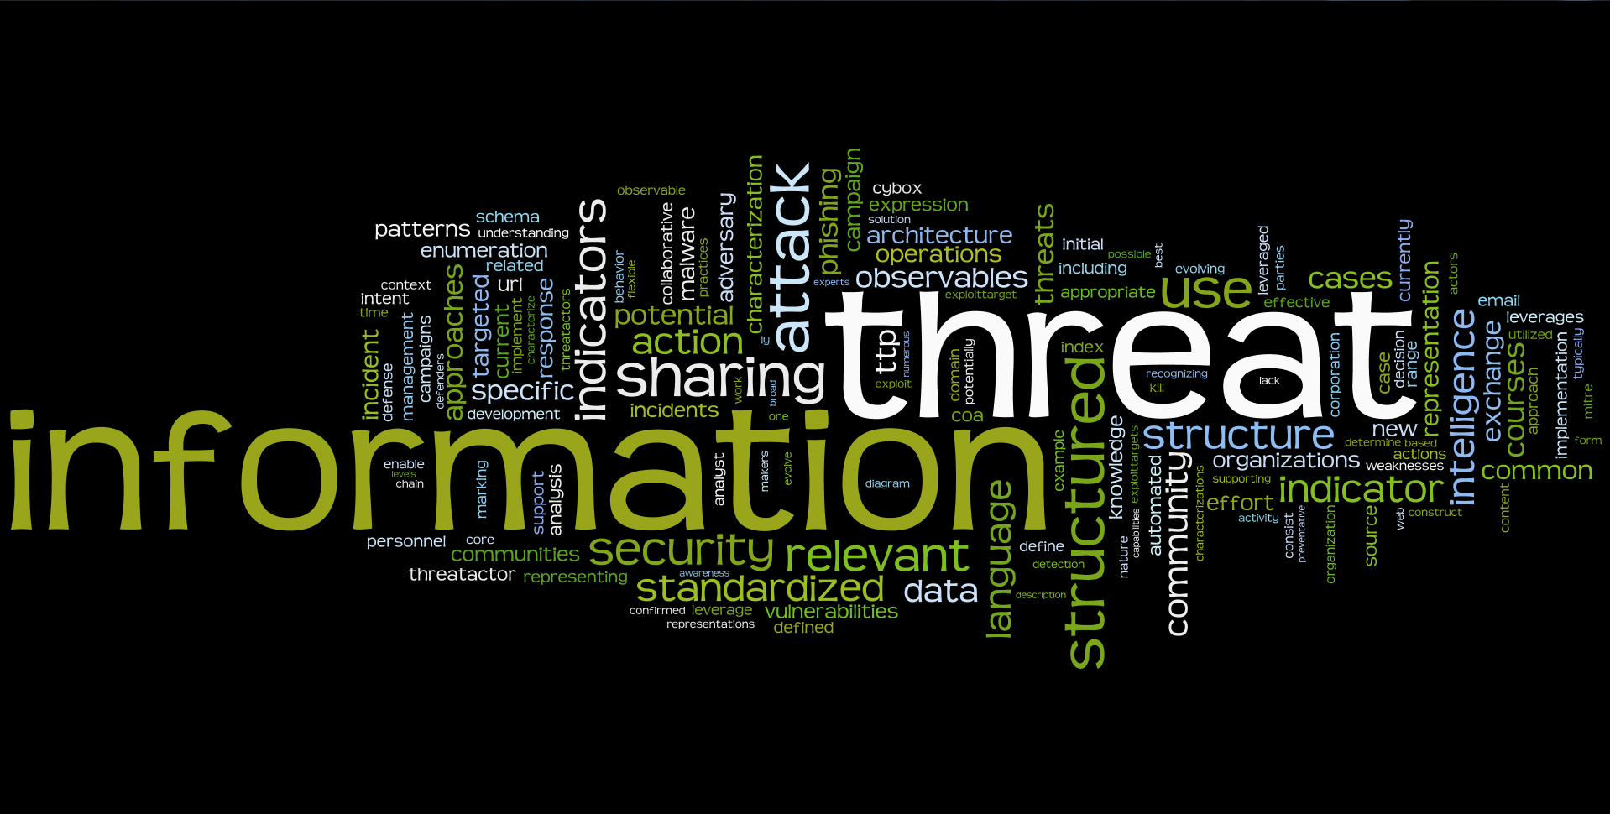

Orient on the Adversary!
We want you to be part of the conversation.
stix@mitre.org
https://stix.mitre.org

